Slide 1



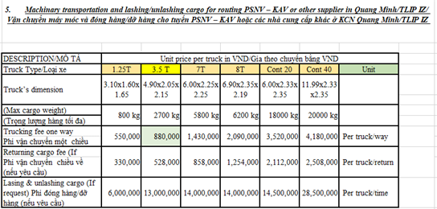
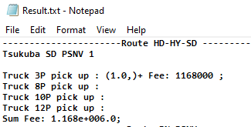
Pick up truck
1/2
The best chose truck – reduce truck fee
Developer: DO MINH TOAN
Apply: December
Expn: 0
Reduce time – Ensure quality
◆Before
◆ After
QUANG MINH AREA
QUANG MINH AREA
Vender 1
Vender 2
Vender 1
Vender 2
Vender 3
Vender 3
TLIP AREA
BAC NINH AREA
TLIP AREA
BAC NINH AREA
Vender 2
Vender 3
Vender 2
Vender 3
Vender 1
Vender 1
Vender 2
Vender 1
Vender 1
Vender 2
HAI DUONG AREA
Manual pick up
HAI DUONG AREA
Auto pick up
Vender 1
Vender 1
Vender 2
Vender 2
Manual pick up truck ➔ Loss time : 45 min / day
Easy to make mistake , high truck fee
Automation pick up truck : 5 min/ day
➔ Save time : 40 min/ day
Ensure quality, reduce truck fee
Notes:
Next theme, this is database daily checking improved by development team.

